Slide 1


Component Preliminary Design Review
Overview:
Needs and Requirements (Updated)
Selected Design
Selected Design with Changes
Analysis and Verification
Risk Assessment
By: Edward Lee

Slide 2
Needs and Requirements
Overview of Needs and Requirements
Tank/Engine mounts must have OD of 12.75’’
FOS of at least 1.3
Optimize weight of each tank mount (LOX,LNG, He) by reducing cross-section
Run buckling simulation with proper spacing of the tank mounts and appropriate forces
Changed weight → new acceleration
Distribution of weight of plumbing on tank mounts
Modify vertical assembly with the changed bulkhead and run buckling simulation
Force on LOX tank mount (weight of the bulkhead + weight of plumbing on top of LOX)
Force on Methane tank mount
Force on He tank mount
Thrust force on engine mount
Updated Requirements
Changed mass estimation from 150 lb → 271 lb (link to updated weight calculation)

Slide 3
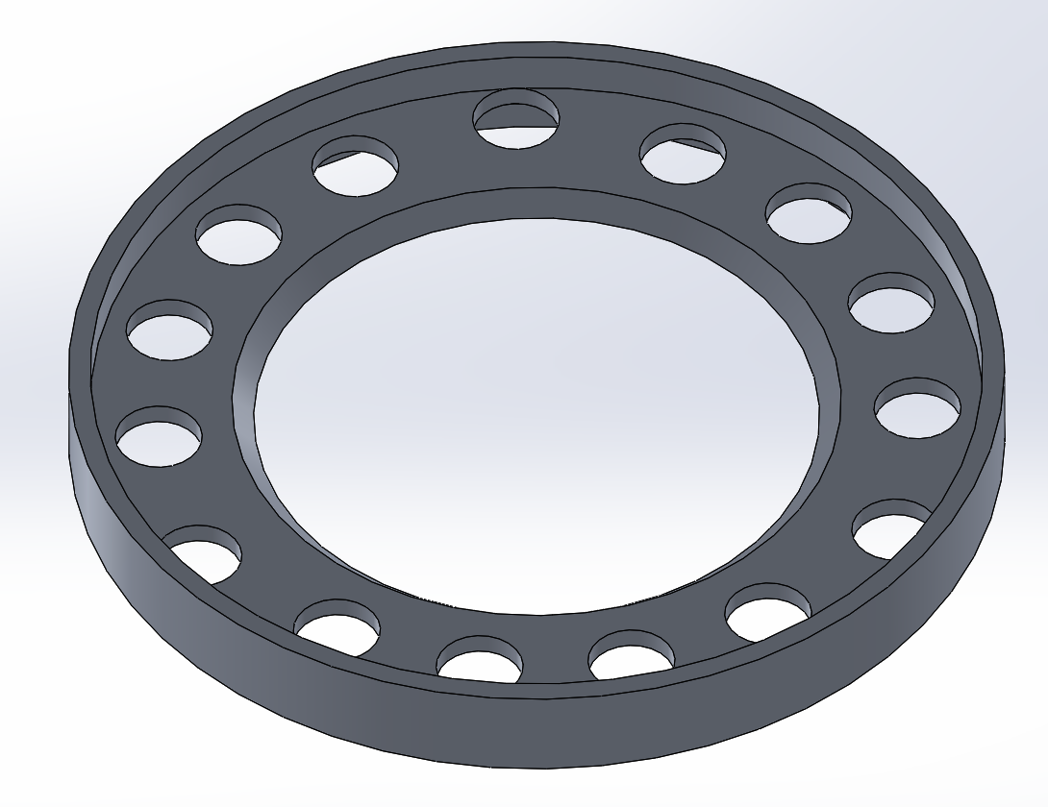
Selected Design
Prior Tank Mount Design
Designed and verified by Noah Yim in Winter 2020
Specification
OD: 10.75’’
6.5” inner hole with 45° chamfer
0.25” thick flange with 1.25” height
Mass of one bulkhead: 1.86 lb
Basecamp link to PTR Bulkhead CDR

Slide 4
Selected Design with Changes
Updated LOX, LNG, He Tank Mounts
Requirements
OD: 12.75
Weight optimization of each tank mount (LOX, LNG, He) by removing excess weight
Changed propellant masses
LOX: 26.03 lb → 47.59 lb
LNG: 8.97 lb → 16.41 lb

Slide 5
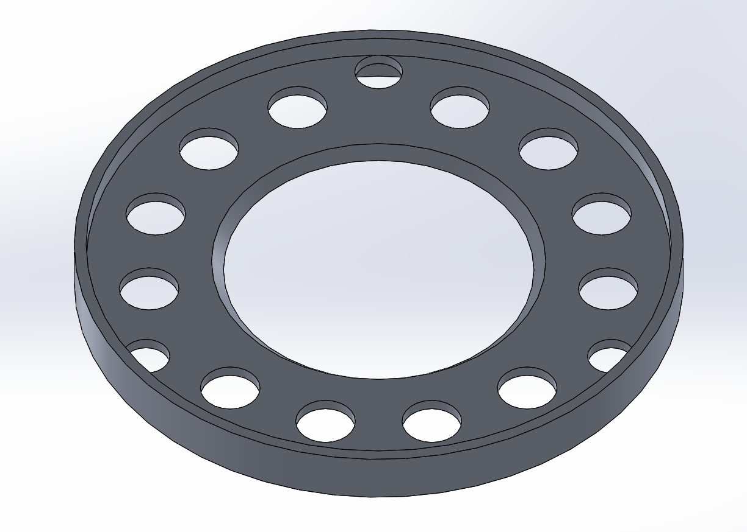
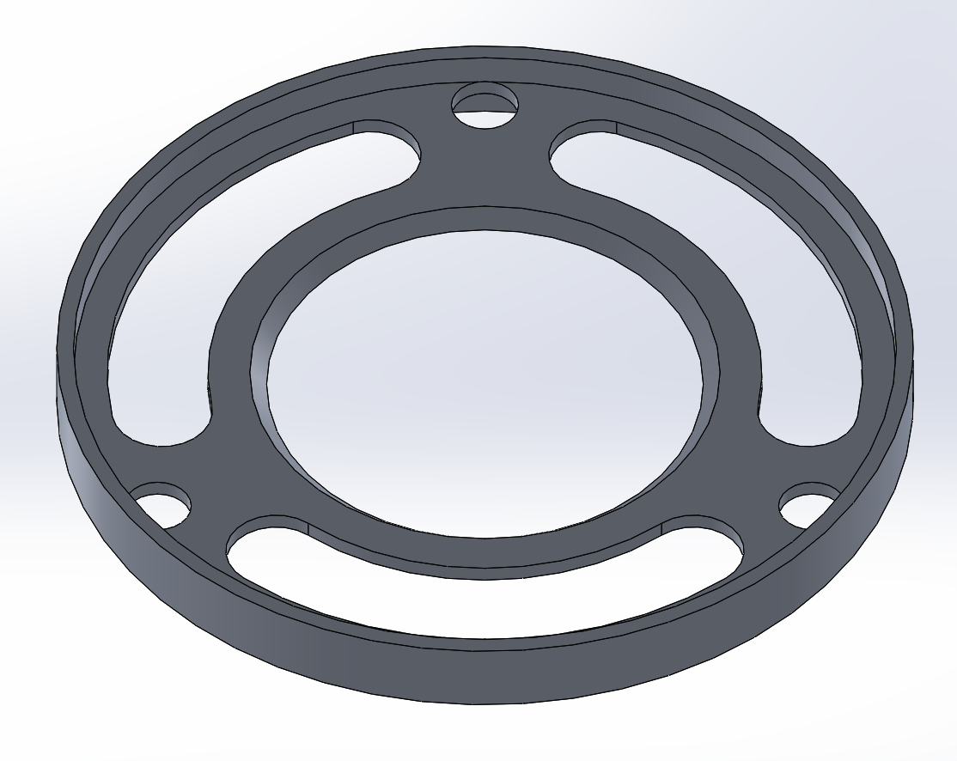
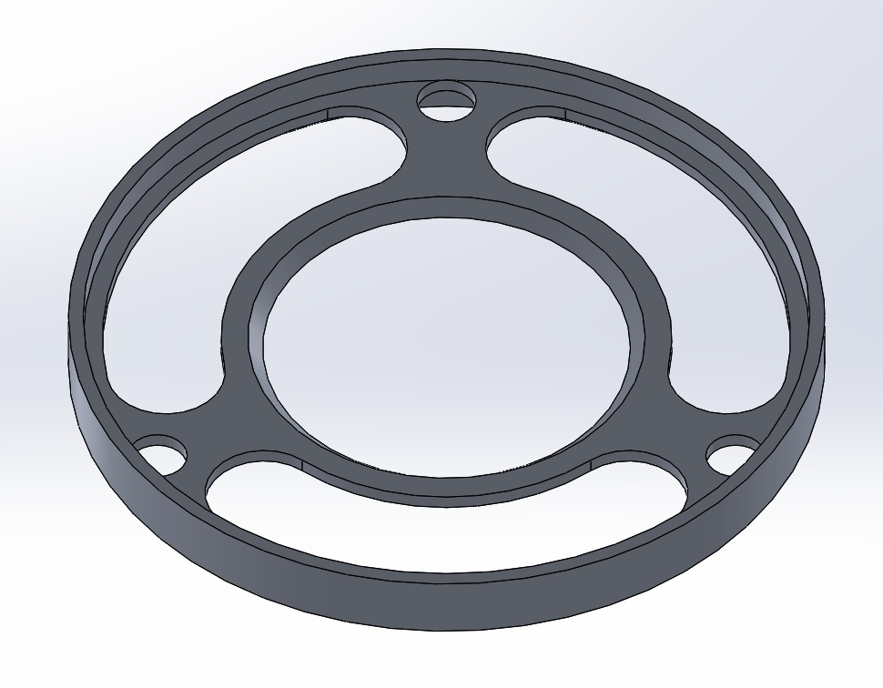
Selected Design with Changes
LOX Tank Mount
OD: 12.75’’
0.25” thick flange with 1.25” height
6.5” inner hole with 45° chamfer
Mass: 2.66 lb
LNG Tank Mount
OD: 12.75’’
0.25” thick flange with 1.25” height
6.5” inner hole with 45° chamfer
Mass: 2.15 lb
He Tank Mount
OD: 12.75’’
0.25” thick flange with 1.25” height
6.2 inner hole with 45° chamfer
Mass: 1.89 lb

Slide 6
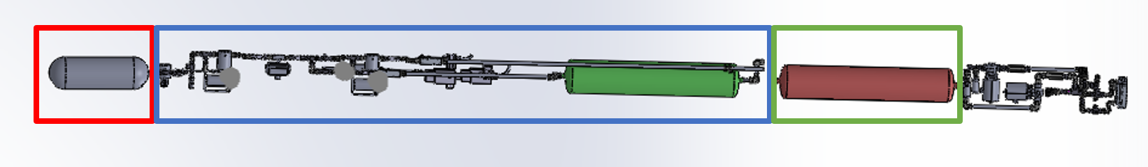
Analysis and Verification
Calculations
Total Acceleration: 54.15807 m/s²
LOX Tank Force: 628.47005 lbf
LNG Tank Force: 145.85145 lbf
He Tank Force: 43.3523 lbf
Initial Conditions and Parameters:
Thrust: F_{thrust} = 1227.156 lbf = 5458.66274 N
Max Rocket Mass (w/o recovery stem and avionics): m_{rocket} = 271.36 lb = 123.08683 kg
Dry Tank Mass (assumption): m_{tank,dry} = 10 lb = 4.5359 kg
Plumbing Mass Supported by LOX Tank: = m_{plumbing,LOX} = 56.21 lb = 25.49643 kg
Plumbing Mass Supported by LNG Tank: = m_{plumbing,LNG} = 0 lb = 0 kg
LOX Propellant Mass: m_{LOX} = 47.59 lb = 21.58646 kg
LNG Propellant Mass: m_{LNG} = 16.41 lb = 7.44345 kg
He Tank Mass: m_{He} = 7.85 lb = 3.5607 kg
Calculations:
Total LOX Tank Mass + Plumbing:
m_{total,LOX} = m_{tank,dry} + m_{LOX} + m_{plumbing,LOX} =
4.5359 + 21.58646 + 25.49643 = 51.61879 kg
Total Methane Tank Mass + Plumbing:
m_{total,LNG} = m_{tank,dry} + m_{LNG} + m_{plumbing,LNG} =
4.5359 + 7.44345 + 0 = 11.97935 kg
Acceleration from Rocket:
a_{rocket} = F_{thrust}/m_{rocket} = 44.34807 m/s²
a_{total} = a_{rocket} + g = 54.15807 m/s²
LOX Tank Force:
F_{tank,LOX} = m_{total,LOX} *a_{total} = 2795.57404 N = 628.47005 lbf
Methane Tank Force:
F_{tank,LNG} = m_{total,LNG} *a_{total} = 648.77956 N = 145.85145 lbf
He Tank Force:
F_{tank,He} = m_{He}*a_{total} = 192.84064 N = 43.3523 lbf

Slide 7
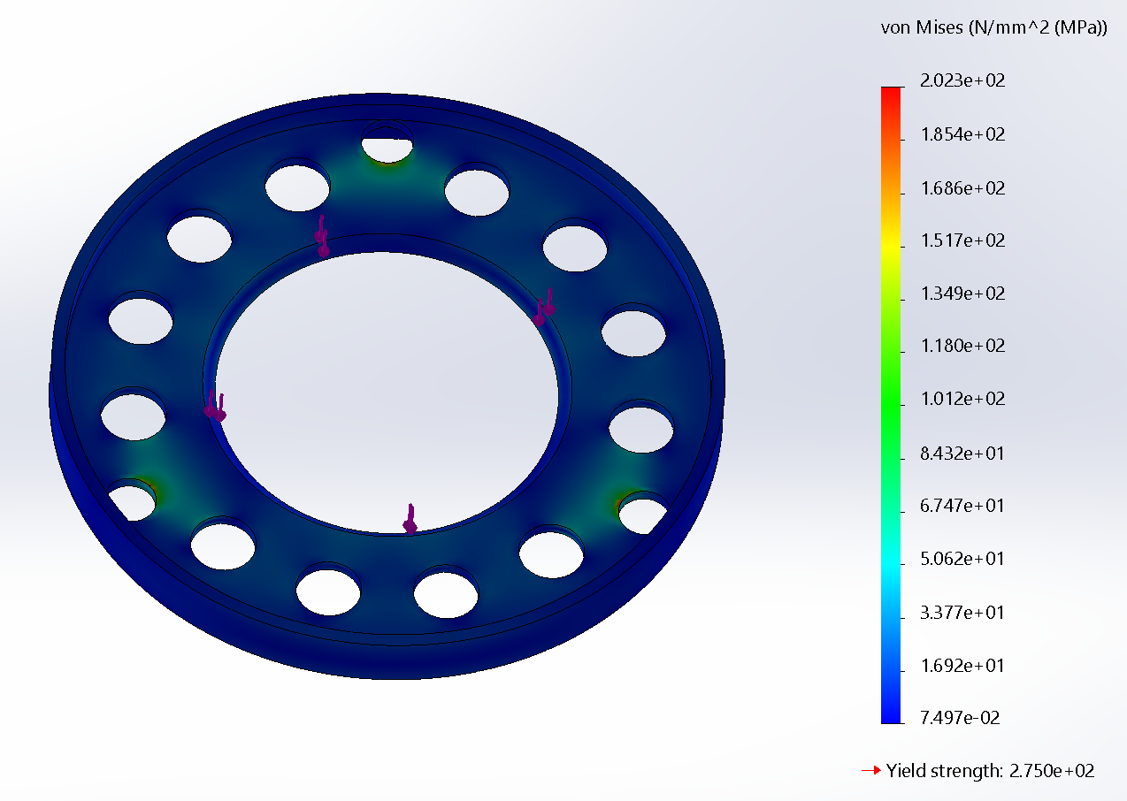
Bulkhead Analysis and Verification
LOX Bulkhead Stress Simulation
202.3 MPa

Slide 8
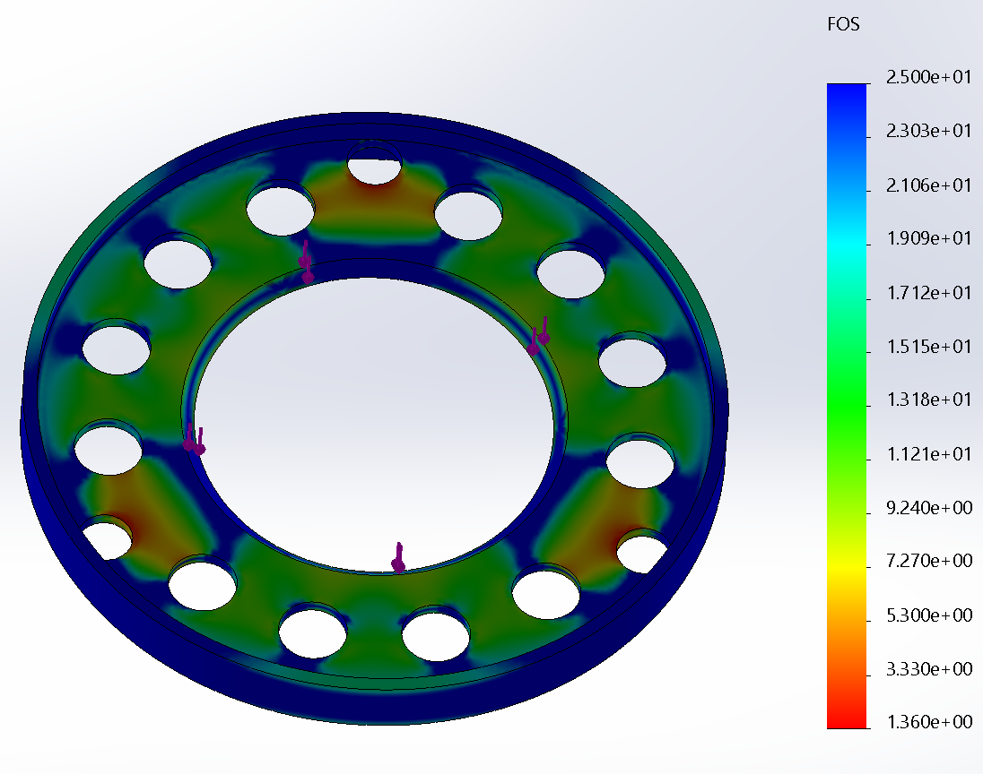
Bulkhead Analysis and Verification
LOX Bulkhead FOS Simulation
Minimum FOS: 1.4

Slide 9
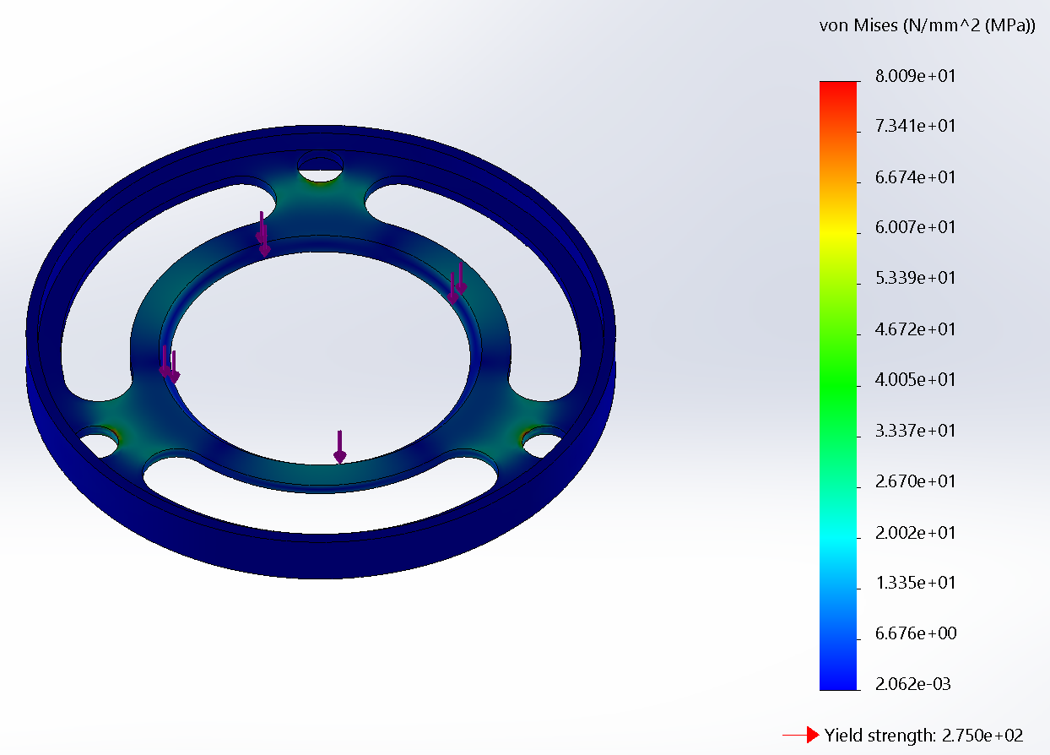
Bulkhead Analysis and Verification
LNG Bulkhead Stress Simulation
80.09 MPa

Slide 10
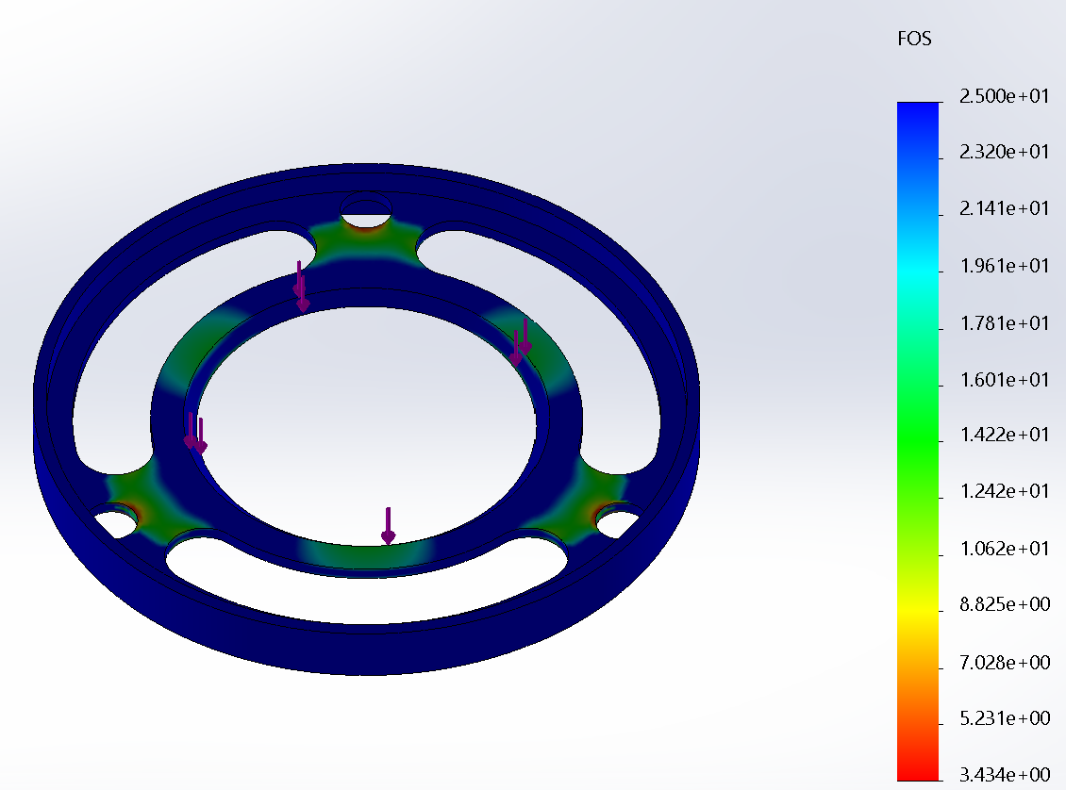
Bulkhead Analysis and Verification
LNG Bulkhead FOS Simulation
Minimum FOS: 3.4

Slide 11
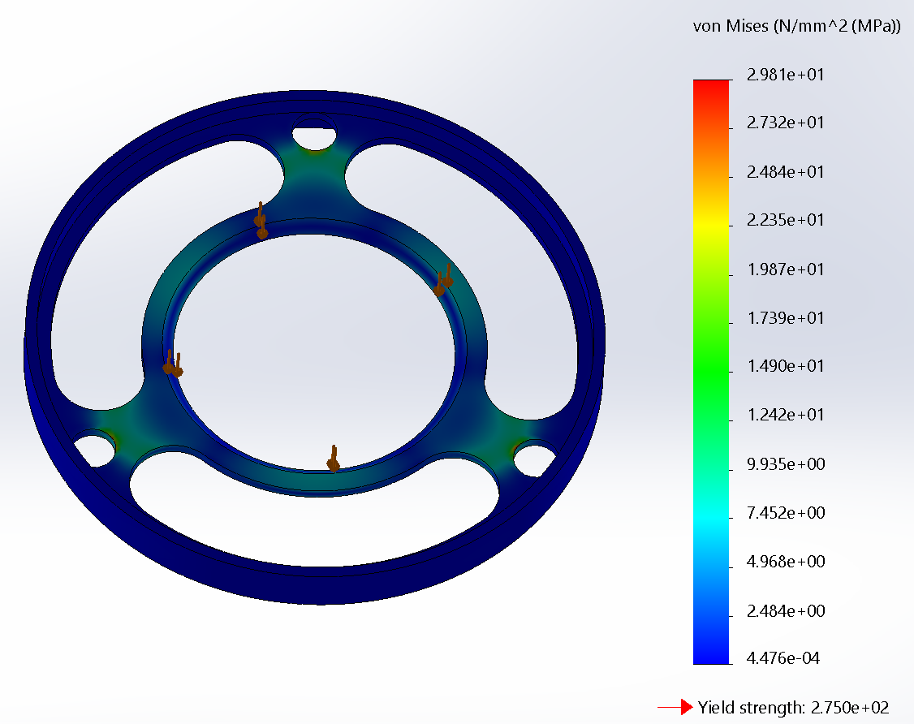
Bulkhead Analysis and Verification
He Bulkhead Stress Simulation
29.81 MPa

Slide 12
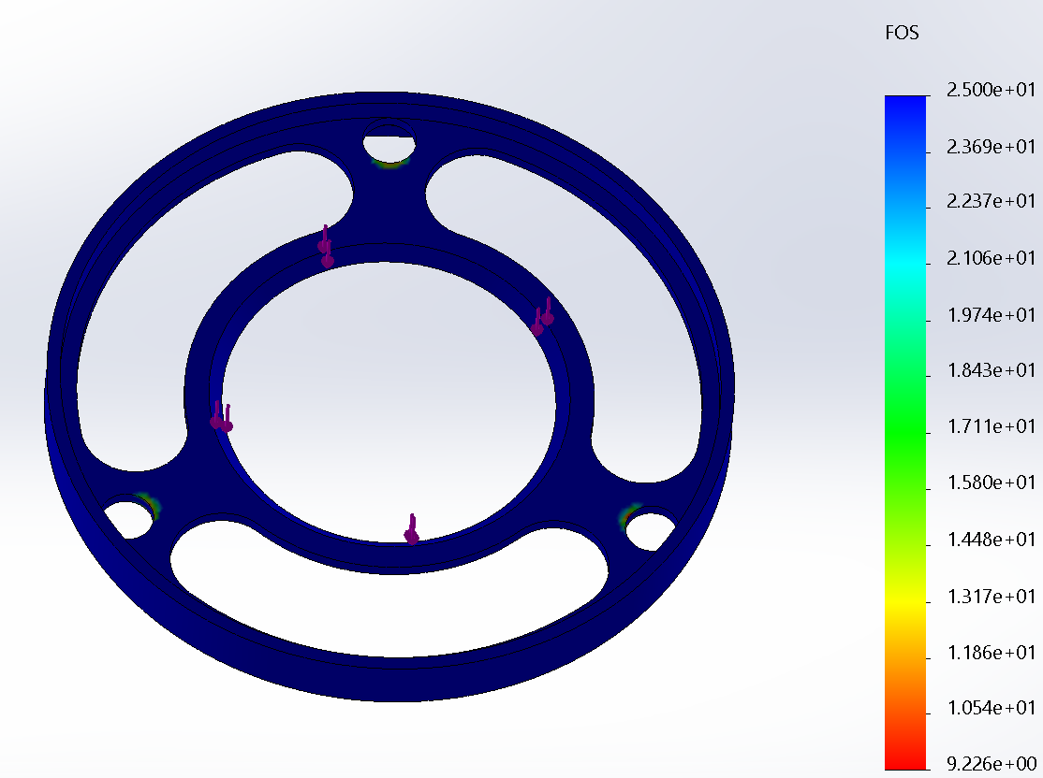
Bulkhead Analysis and Verification
He Bulkhead FOS Simulation
Minimum FOS: 9.2

Slide 13
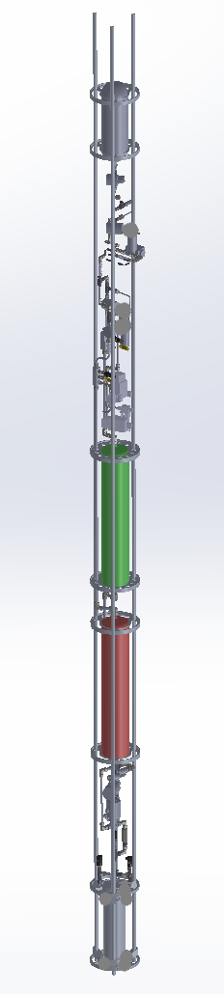
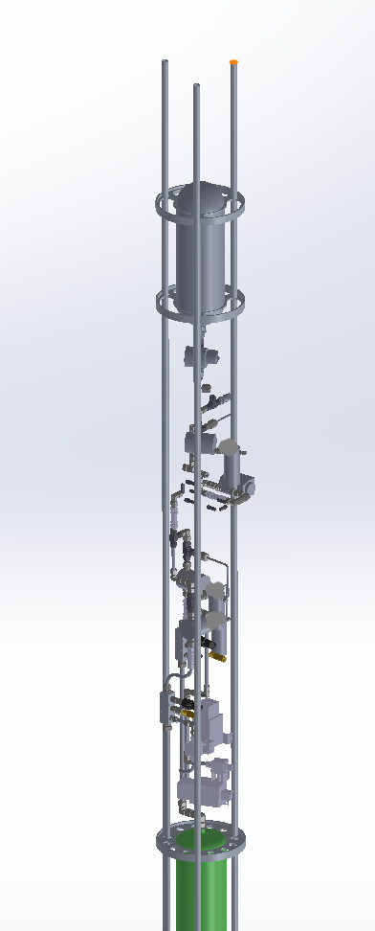
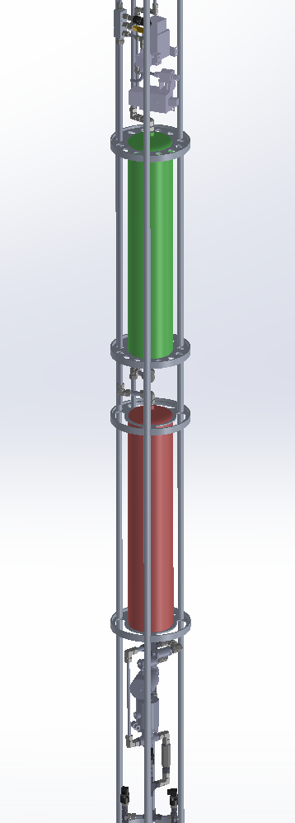
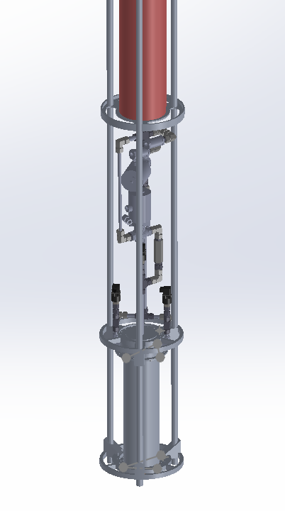
Vertical Assembly Analysis and Verification
Components Shown in Vertical Assembly:
Plumbing system
LOX, LNG, He bulkheads
Engine Mount
Chamber
Struts
Components Not Shown in Vertical Assembly:
Skins
Nosecone
Fins
Recovery
Avionics

Slide 14
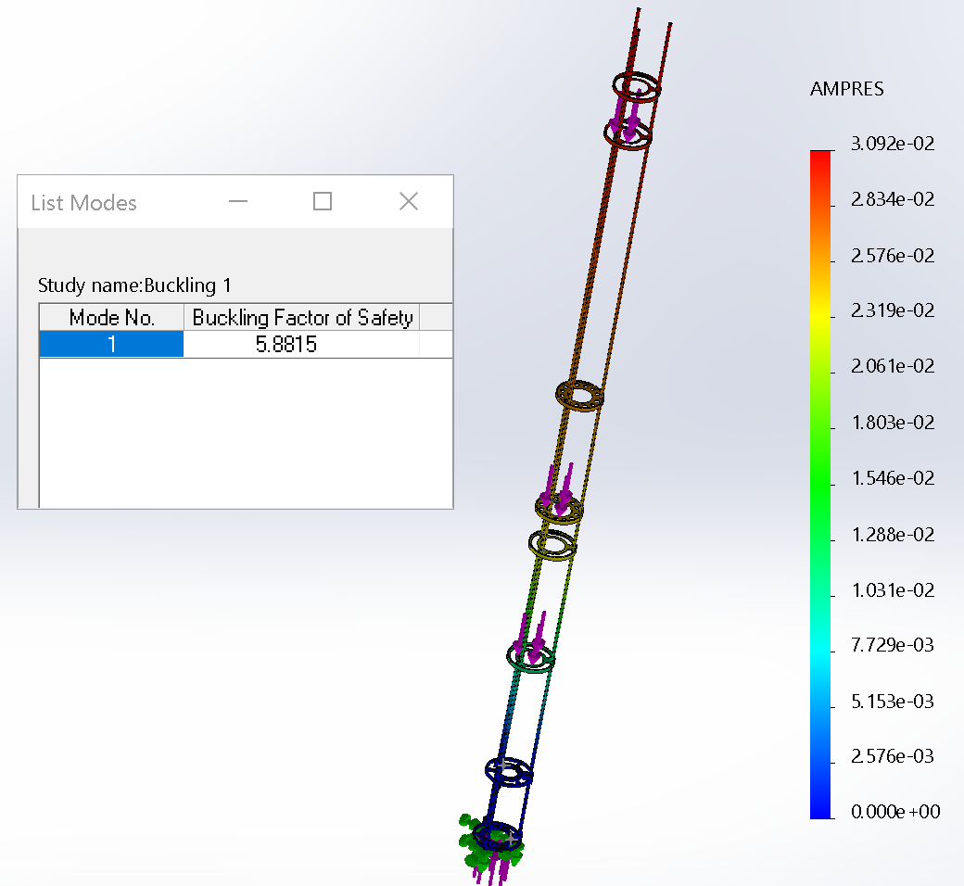
Vertical Assembly Analysis and Verification
Buckling FOS:
FOS of 5.8815 (greater than desired 1.3, but doesn’t consider drag forces)

Slide 15
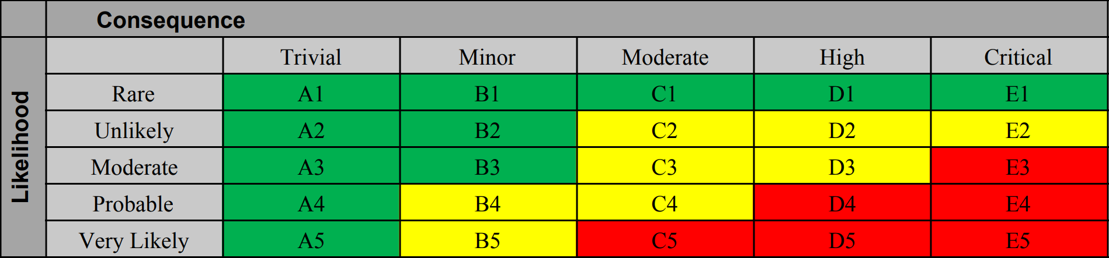
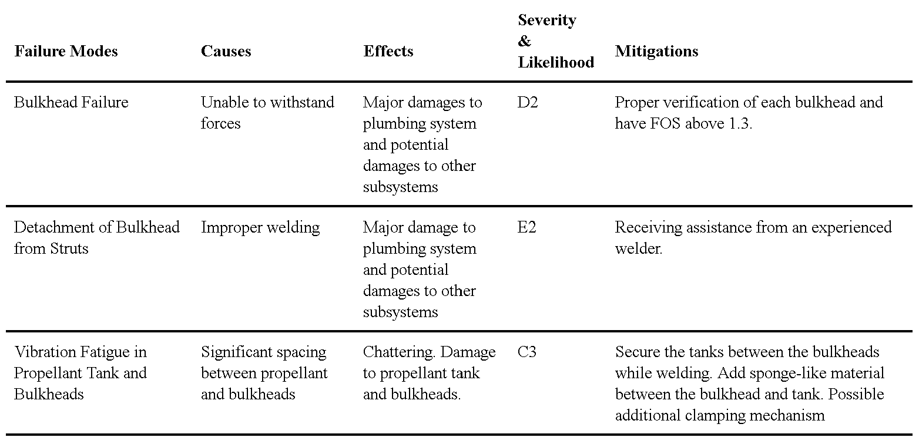
Risk Assessment
FMEA for Vertical Assembly
Specific to interaction between bulkheads, struts, and propellant tanks during flight

